Slide 1
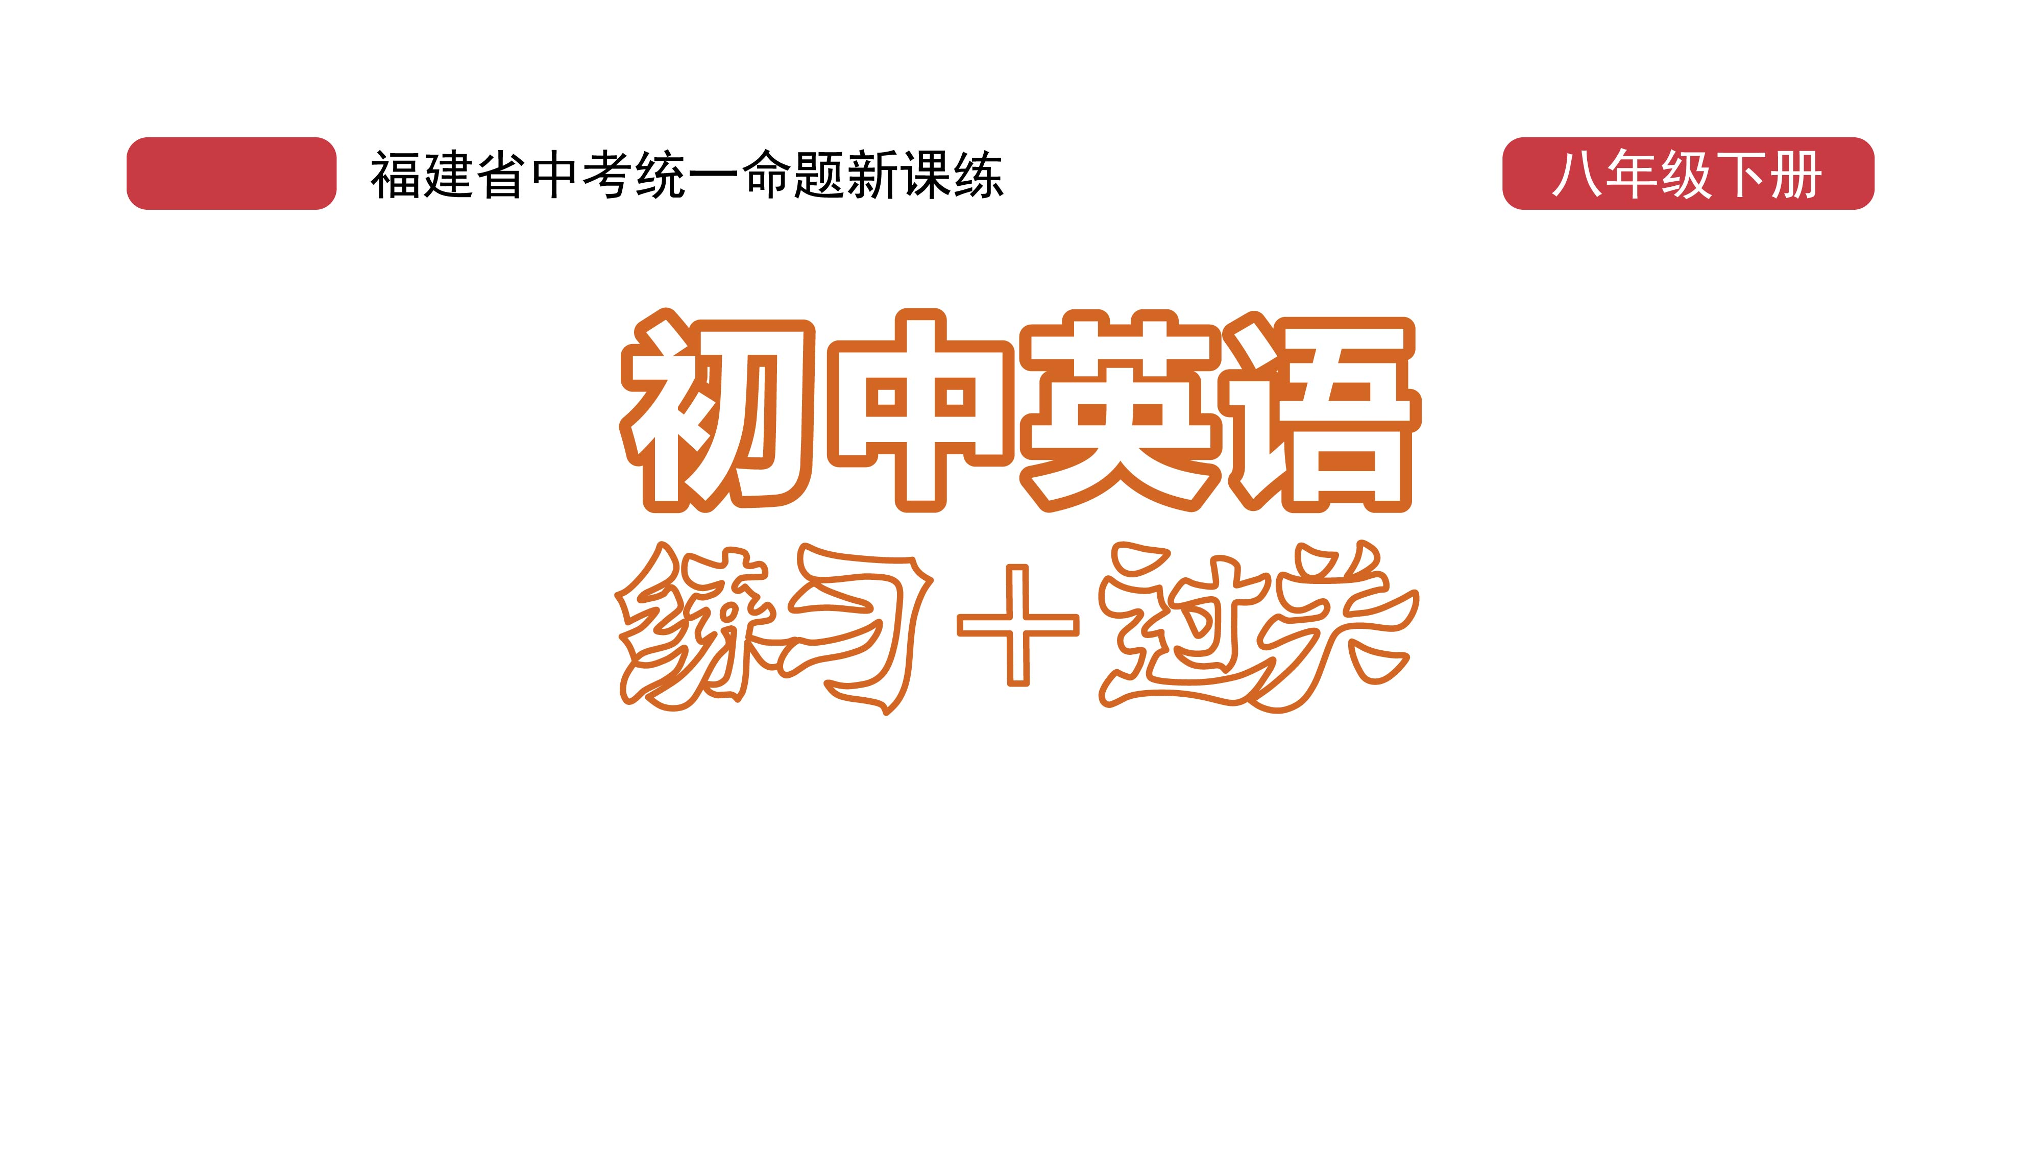
课时练习
模块八 第三章 第三节

Slide 2
一、翻译下列词组。
1. 代表 _______________________
2. 得名 ___________________
3. 变得为……所知 ________________________
4. 从那时起 ________________________
5. 从那时起 _____________________________
6. 与……不同 _____________________________
stand for
get one’s name
become known to …
from then on
not only … but also …
be different from …

Slide 3
一、翻译下列词组。
7. 把……设计成 _______________________
8. 要么……， 要么…… ___________________
9. 两个都； 既……又…… ____________________
10. 个人风格 ________________________
11. 中国的传统文化 __________________________
12. 与全世界 _____________________________
design … as
either … or …
both … and …
personal style
China’s traditional culture
be different from …

Slide 4
二、用括号内所给单词的适当形式填空， 每空一词。
1. The 19th _________ (Asia) Games will take place (举行) in Hangzhou in 2022.
2. The boy always _________ (express) his feelings in his paintings.
3. Bill’s mother is ill. Either Bill or his sister _______ (need) to look after her.
Asian
expresses
needs

Slide 5
二、用括号内所给单词的适当形式填空， 每空一词。
4. In the Song Dynasty, papercutting was used as the __________ (decorate) for gifts.
5. Shenzhen passed its first local law(法规) to protect __________ (person) data(数据) in 2021.
decoration
personal

Slide 6
三、情景交际。
1. 你想知道对方对时装秀的看法， 可以这样问：
What _________________________________________?
2. 你想和对方拍张照， 可以这样说：
Can I _________________________________________?
do you think of the fashion show
take a photo with you

Slide 7
三、情景交际。
3. 妈妈问你弟弟什么时候回来， 你可以在电话里这样对弟弟说：
Mom asked __________________________________.
when you would go/come back (home)

Slide 8
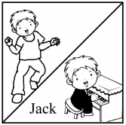
四、看图写话。
1. not only … but also …
Jack can not only dance but also play the piano.

Slide 9

四、看图写话。
2. stand, happiness
The Chinese knot stands for happiness.

Slide 10
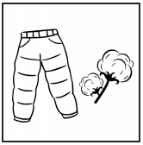
四、看图写话。
3. be made of
The trousers/pants are made of cotton.

Slide 11
五、熟词生义。
1. free A. adj. 自由的 B. adj. 空闲的
C. adj. 免费的 D. vt. 释放； 使自由
_____ (1) Students these days have very little free time．
_____ (2) You are free to come and go as you like.
_____ (3) There is no such thing as a free lunch.
_____ (4) Art frees imagination(想象力).
B
A
C
D

Slide 12
五、熟词生义。
2. express A. v. 表达， 表示 B. vt. 快递邮寄
C. adj. 特快的， 高速的 D. n. 快运服务
____ (1) The express train makes very few stops.
____ (2) Words cannot express what I feel about you.
____ (3) Amy expressed the book yesterday.
____ (4) Please send the letter by express.
B
D
C
A

Slide 13


